Slide 1

7th Grade Math
Unit 7, Lesson 3 Constructing Circle Graphs Volume 1, pg. 303

Slide 2


Benchmark
MA.7.DP.1.4
Use proportional reasoning to construct, display, and interpret data in circle graphs.
volume 1, pg. 303

Slide 3
Integrated Mathematical Thinking and Reasoning Standards
MA.K12.MTR.2.1 Demonstrate understanding by representing problems in multiple ways.
MA.K12.MTR.6.1 Assess the reasonableness of solutions.
volume 1, pg. 303

Slide 4

Learning Target
I can construct a circle graph given categorical data.
volume 1, pg. 303

Slide 5

Warm-Up
volume 1, pg. 303

Slide 6
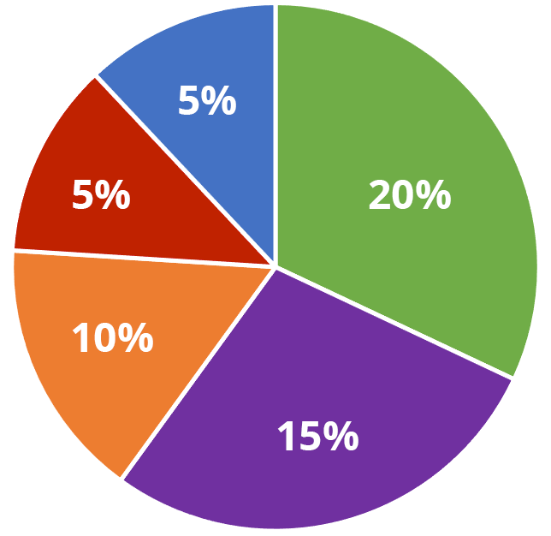
7.3.1 Warm-Up: Data Display
Consider the circle graph.
What do you notice about the graph?
Explain whether or not this is a valid display of data.
volume 1, pg. 303

Slide 7

Guided Instruction
volume 1, pg. 304

Slide 8

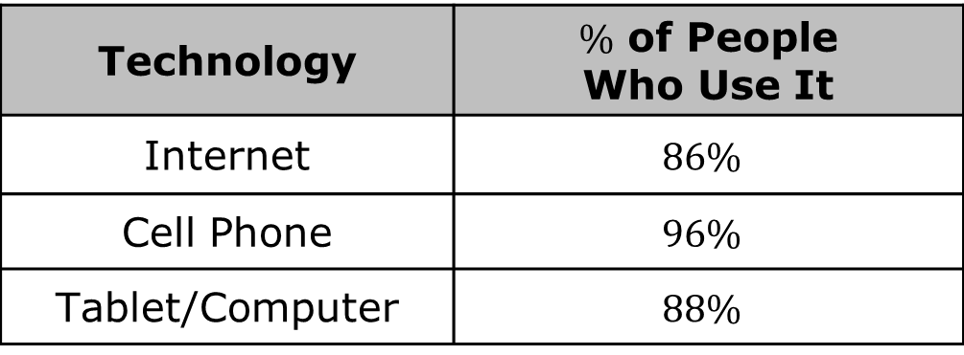
7.3.2 Guided Instruction: Circle Graphs
A circle graph, also called a pie chart, is a visual display of categorical data. The whole set of data is represented by the circle and its interior. The categories are represented by fractional parts of the circle.
The survey data in the table shows data collected in 2019 on the use of different technologies in the United States.
Technology | $\%$ of People Who Use It
Internet | $$86\%$$
Cell Phone | $$96\%$$
Tablet/Computer | $$88\%$$
volume 1, pg. 304

Slide 9
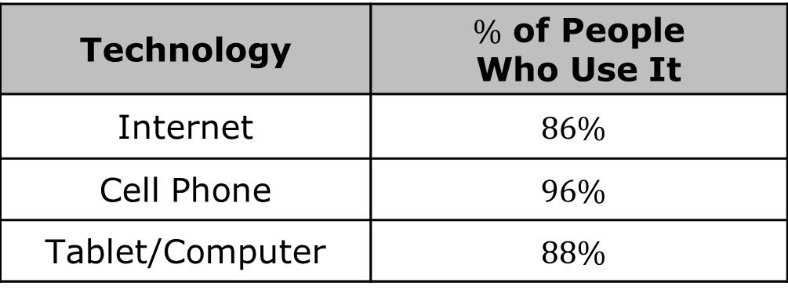
Technology | $\%$ of People Who Use It
Internet | $$86\%$$
Cell Phone | $$96\%$$
Tablet/Computer | $$88\%$$
How could someone using more than one of the technologies in the survey affect the percentages?
Discuss with your partner whether the data in the table can be displayed in a circle graph. Summarize your discussion.
volume 1, pg. 304

Slide 10
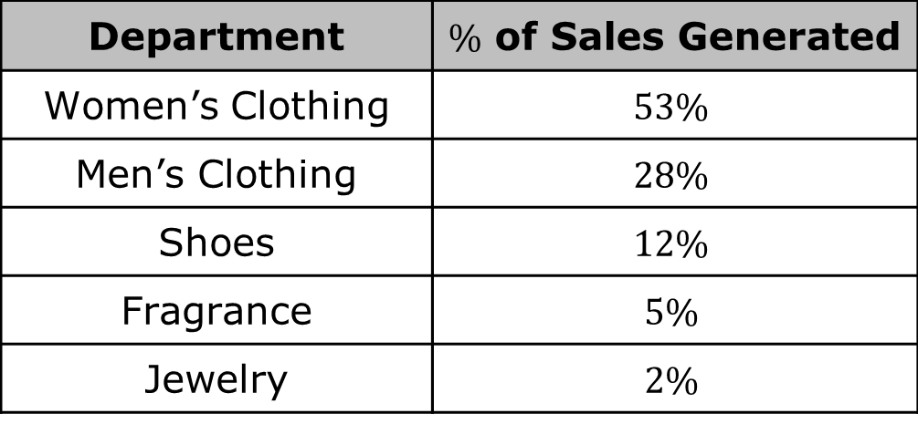
A store collected data on the percentage of sales that each department generated for the store’s total revenue over three months.
With your partner, compare the department store data to the technologies data. Describe any similarities or differences you notice.
Discuss with your partner why a circle graph is a good display for the department store data.
Department | $\%$ of Sales Generated
Women’s Clothing | $$53\%$$
Men’s Clothing | $$28\%$$
Shoes | $$12\%$$
Fragrance | $$5\%$$
Jewelry | $$2\%$$
volume 1, pg. 304

Slide 11
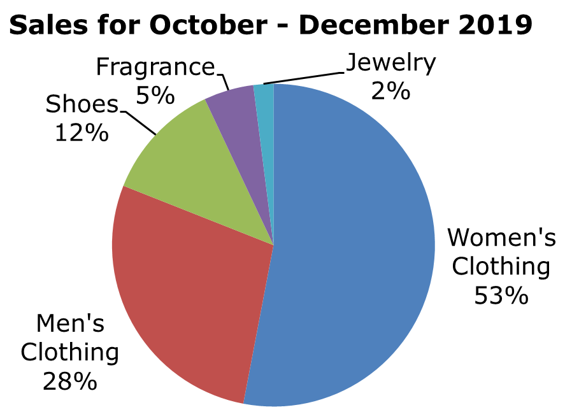
The circle graph displays a store’s sales by department over a three-month period.
Describe the information that was included for each sector.
Which department had the largest percentage of sales?
Discuss with your partner how to find the angle measure for each sector.
volume 1, pg. 304

Slide 12
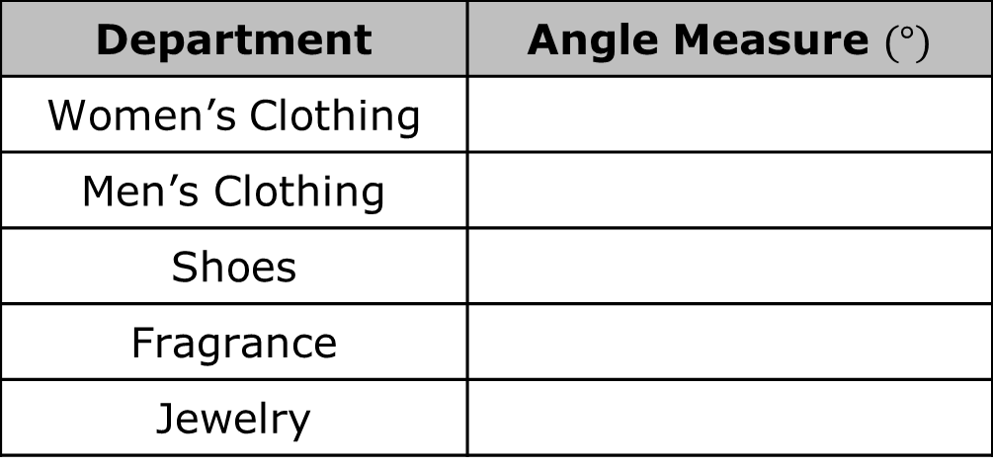
Find the corresponding angle measure for each department. Round to the nearest whole number.
What is the sum of all five calculated angle measures?
Use your protractor to compare your calculated values with the degrees of each sector in the actual circle graph. Then, discuss with your partner how they compare.
Department | Angle Measure $(°)$
Women’s Clothing
Men’s Clothing
Shoes
Fragrance
Jewelry
volume 1, pg. 305

Slide 13

Collaboration
volume 1, pg. 306

Slide 14

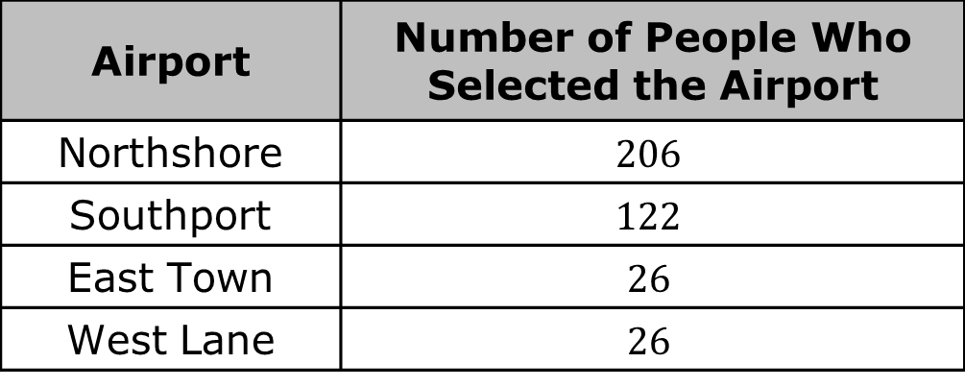
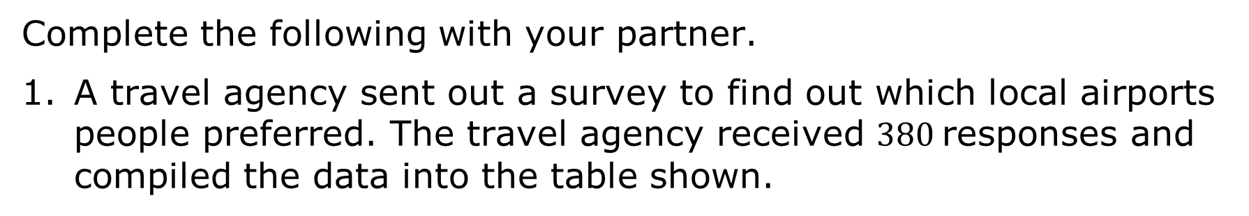
7.3.3 Collaboration: Constructing a Circle Graph
Complete the following with your partner.
A travel agency sent out a survey to find out which local airports people preferred. The travel agency received $380$responses and compiled the data into the table shown.
Airport | Number of People Who Selected the Airport
Northshore | $$206$$
Southport | $$122$$
East Town | $$26$$
West Lane | $$26$$
volume 1, pg. 306

Slide 15
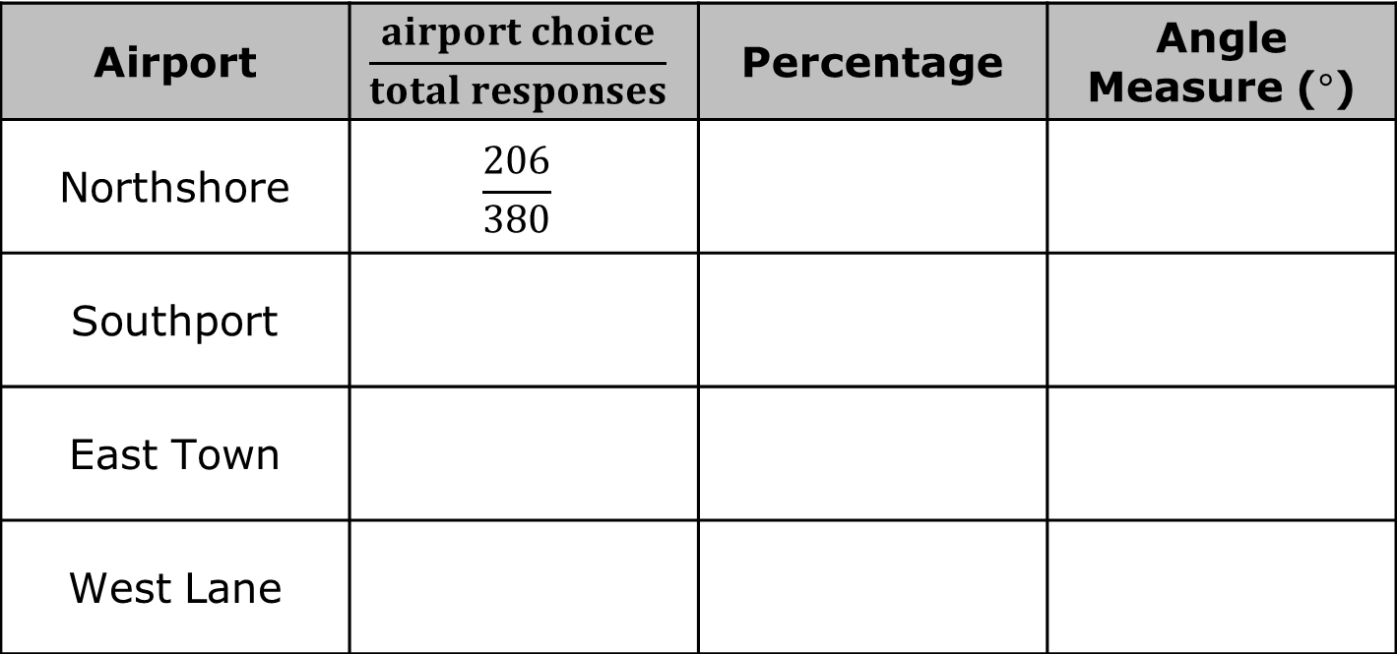
Use the data to complete the table. Round all values to the nearest whole number.
Airport | $$\frac{airport choice}{total responses}$$ | Percentage | Angle Measure ($°$)
Northshore | $$\frac{206}{380}$$
Southport
East Town
West Lane
volume 1, pg. 306

Slide 16
Use the data in the table and a protractor to construct a circle graph.
volume 1, pg. 306

Slide 17
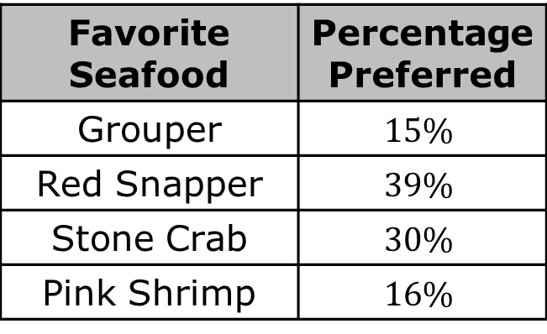
A restaurant is developing a new menu, so they decide to survey people’s favorite local seafood. The results of the survey are shown in the table.
Use the data and a protractor to construct a circle graph.
Summarize the process you and your partner used to construct the circle graph.
Favorite Seafood | Percentage Preferred
Grouper | $$15\%$$
Red Snapper | $$39\%$$
Stone Crab | $$30\%$$
Pink Shrimp | $$16\%$$
volume 1, pg. 306

Slide 18

Your Turn
volume 1, pg. 307

Slide 19
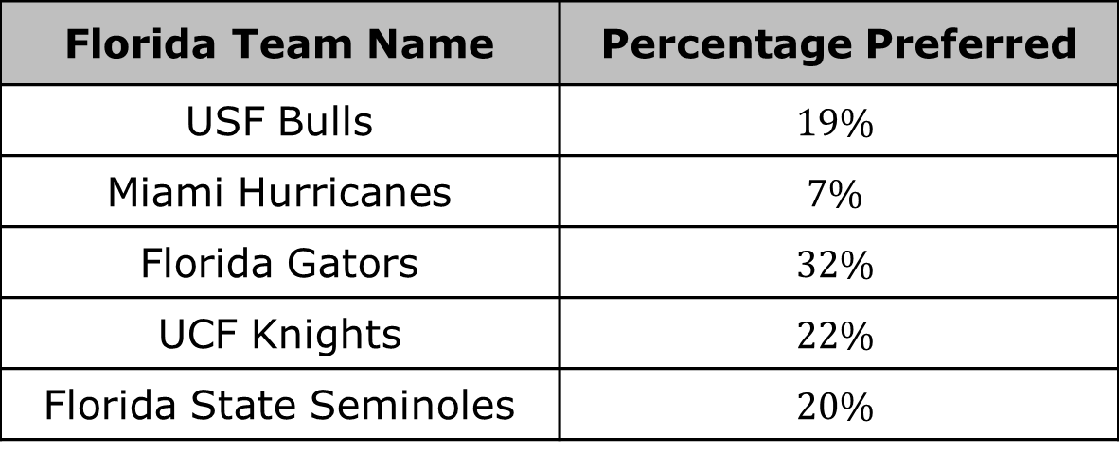
7.3.4 Your Turn!
The Pasco Middle School Pirates are conducting a survey to determine their students’ favorite Florida sports team name. The results of the survey are shown in the table.
Florida Team Name | Percentage Preferred
USF Bulls | $$19\%$$
Miami Hurricanes | $$7\%$$
Florida Gators | $$32\%$$
UCF Knights | $$22\%$$
Florida State Seminoles | $$20\%$$
volume 1, pg. 307

Slide 20
Use the data and a protractor to construct a circle graph.
volume 1, pg. 307

Slide 21

Wrap-Up
volume 1, pg. 308

Slide 22
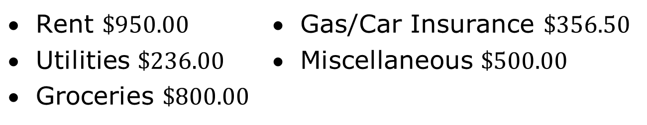
7.3.5 Wrap-Up: Ticket Out the Door
The Rudolph Family’s top five monthly expenses are as follows:
Rent $\$950.00$ Utilities $\$236.00$ Groceries $\$800.00$ | Gas/Car Insurance $\$356.50$ Miscellaneous $\$500.00$
volume 1, pg. 308

Slide 23
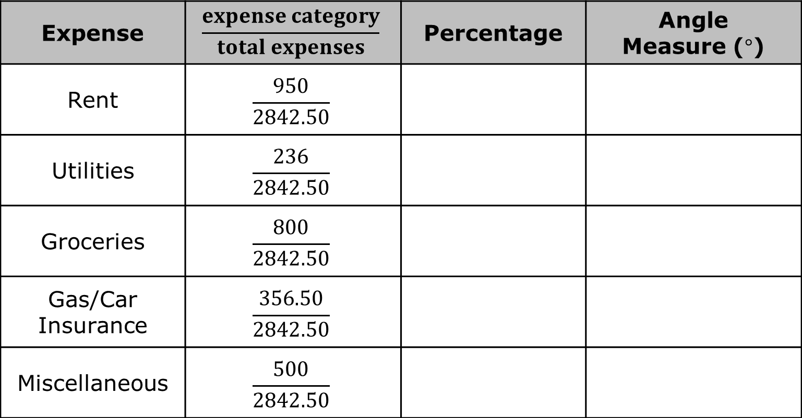
Complete the table. Round each percentage and angle measure to the nearest whole number.
Expense | $$\frac{expense category}{total expenses}$$ | Percentage | Angle Measure ($°$)
Rent | $$\frac{950}{2842.50}$$
Utilities | $$\frac{236}{2842.50}$$
Groceries | $$\frac{800}{2842.50}$$
Gas/Car Insurance | $$\frac{356.50}{2842.50}$$
Miscellaneous | $$\frac{500}{2842.50}$$
volume 1, pg. 308

Slide 24
Construct the corresponding circle graph.
volume 1, pg. 308

